Slide 1

Vision control
Source: http://ia-latam.com/2019/01/28/la-ia-se-integrara-en-la-mayoria-de-los-aspectos-de-la-vida-humana/

Slide 2



Project Team
FH-Prof. Dipl.-Ing. Dr. Wolfgang Werth
MSc Heinz-Peter Ulrich Liechtenecker
Gregor Fritz
Laurenz Hundgeburth

Slide 3
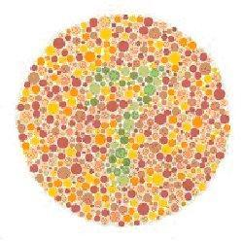

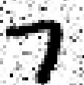
Thought Experiment on Abstraction
Source1: http://www.marcelhaas.com/index.php/author/marcelhaas_em0ahm/
Source2: http://www.uni-koeln.de/~jschween/spiel/farbtafeln/farbtafeln.html

Slide 4
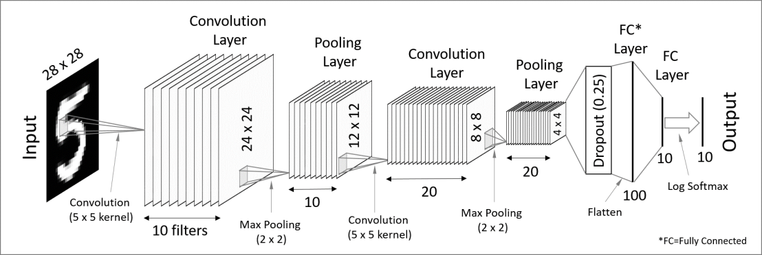
Background
Convolutional Neural Network
Source 1: https://codetolight.wordpress.com/2017/11/29/getting-started-with-pytorch-for-deep-learning-part-3-neural-network-basics/

Slide 5




Goal
Sensor
Control
Camera
Motor
USB
Motor Power
Motor Encoder
PC
RS232
MCU

